Slide 1

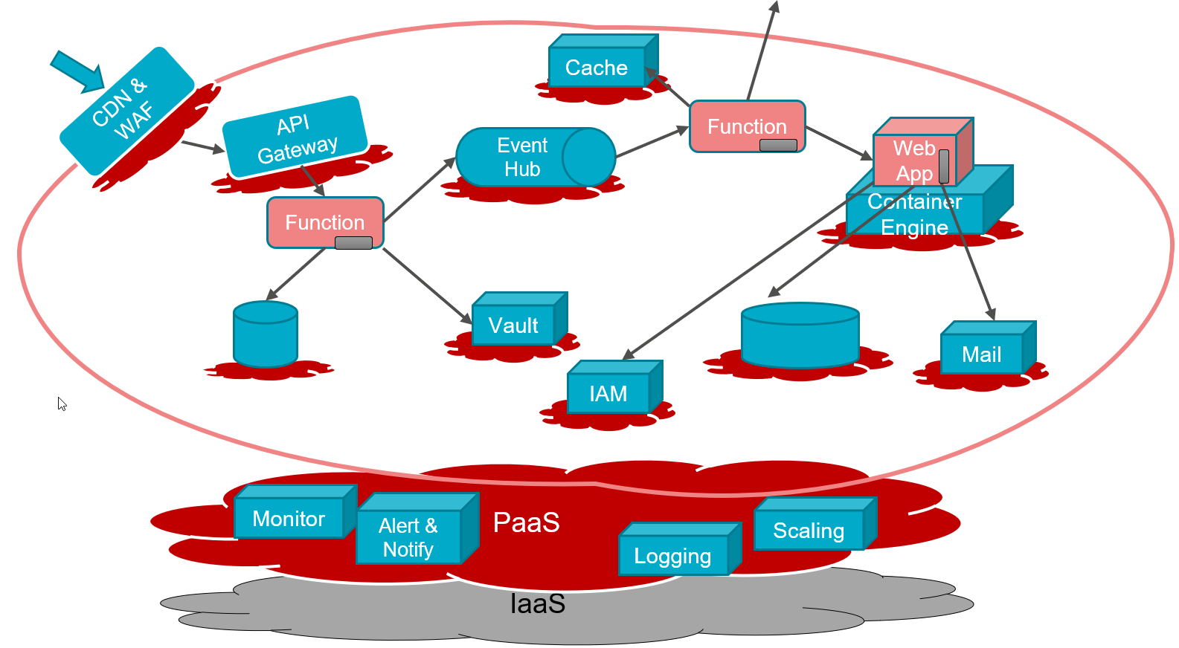




Cloud Native Application Development - build fast, cheap, scalable and agile software on Oracle Cloud Infrastructure
UKOUG Spring Tech Summit, April 2021
Lucas Jellema, CTO & Architect AMIS | Conclusion
Sources and slides: bit.ly/cloud-native-ogb-apacouc2020

Slide 2
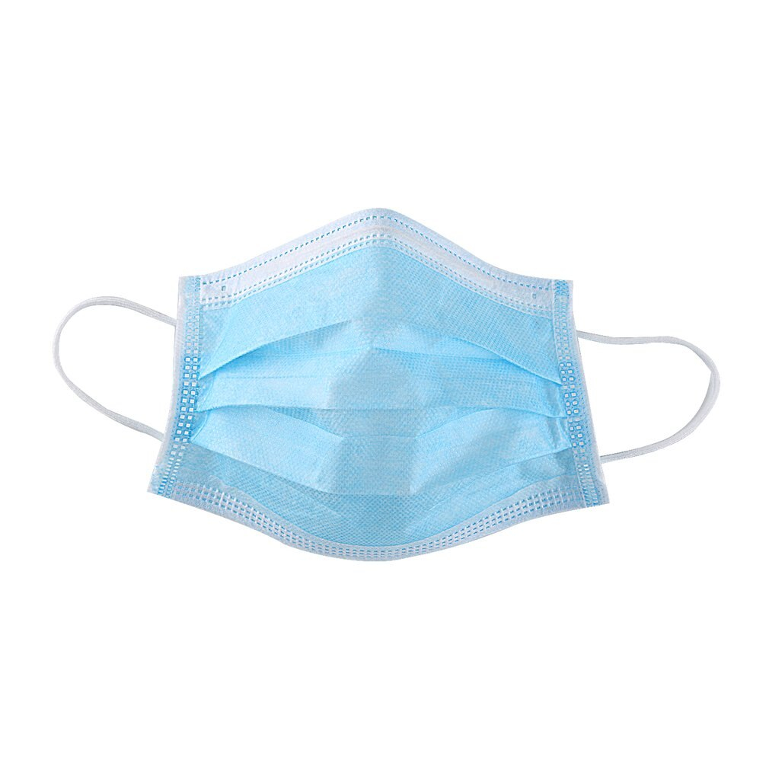
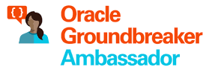



Lucas Jellema CTO for AMIS | Conclusion Cloud Solution Architect
lucas.jellema@amis.nl | technology.amis.nl | @lucasjellema | lucas-jellema

Slide 3
A traditional application
UI
API
WebApp
Platform & Language runtime features (transaction management, HTTP request handling, state management & in memory caching, IAM, …
3rd party libraries & frameworks
Monolith, Microservice, Module
Custom Code
Database (RDBMS?)
Java EE
JVM
Operating System
Hardware

Slide 4
Cloud Native Application
Cache
CDN & WAF
API Gateway
Function
Event Hub
Web App
Container Engine
Function
IAM
Managed
Quick Provision & Decommission
Distributed
Automated
Pay per use/TCO
Vendor takes runtime responsibility
Enterprise grade platform accessible to startups
Rapid Innovation
Security & Availability
Scale
Vault
Mail
Data Integration
PaaS
Monitor
Alert & Notify
Scaling
Logging
IaaS
Notes:
Out of the box PaaS services and facilities
persistence, routing/throttling/buffer/queue/retry
IDM, key mgt, encryption/decryption
Distribution, CDN, regional failover
Monitor, log, alert/notification
Scalability (up & down)
Quick Rampup
Emphasis on interaction points: APIs, Events/ message format
Less emphasis on implementation of PaaS (platform) services
MongoDB API – implemented by Azure Cosmos DB, MongoDB, Minimongo and AWS Document DB and soon Oracle Autonomous JSON
Kafka API – Azure Event Hub, OCI Streaming, AWS Managed Streaming
JDBC/SQL – Relational Database (Oracle, SQL Server, PostgreSQL, MySQL) and even NoSQL (Oracle NoSQL, Cassandra, Hadoop)

Slide 5
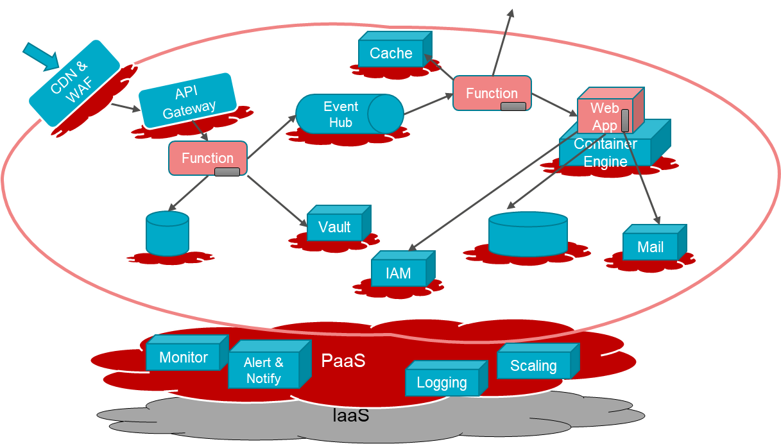
Characteristics of Cloud Native Applications
Modern – born in the cloud (era)
Emphasis on interaction (and decoupling) points:
Between custom components: APIs, Events / message format
From custom to PaaS Services: Service APIs, Formats and Protocols
Less emphasis on [and insulation from?] implementation of PaaS (platform) services
Key are industry standard APIs that are implemented by many different services
Custom code in small, simple units
No explicit Infrastructure (serverless, software defined) & managed Platform components
Stateless and Dynamically Scalable (Elastic) – expand and contract
Pay per Use
Automation – no hands on ACC and Production (speed, repeatability, dynamic adjustment)
Infrastructure/Platform as Code & Application CI/CD [pipelines]
Notes:
MongoDB API – implemented by Azure Cosmos DB, MongoDB, Minimongo and AWS Document DB and soon Oracle Autonomous JSON
Kafka API – Azure Event Hub, OCI Streaming, AWS Managed Streaming
JDBC/SQL – Relational Database (Oracle, SQL Server, PostgreSQL, MySQL) and even NoSQL (Oracle NoSQL, Cassandra, Hadoop)

Slide 6
Some (PaaS) Cloud Capabilities for Cloud Native development
Functions (serverless application code)
API Gateway
Events / Queued Messages
Data Persistence
Cache
Security
Network access
Web Application Firewall (DDOS & more)
Authentication & Authorization
Credentials & Key Management, En|Decrypt
Automation – CI/CD & DevOps Pipelines
Monitoring
Metrics, notification, logging
Auditing
Cost Control
Monitoring
API Gateway
Function
Security (WAF, Network, Authorization
Event Topic
Data Persistence
Cache
CI/CD & DevOps Pipelines

Slide 7
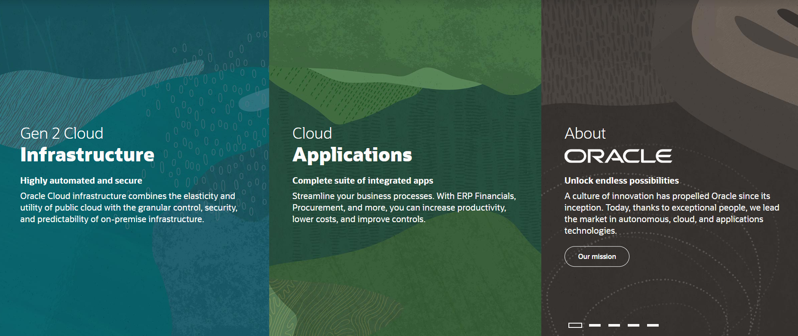
Introducing Oracle Cloud Infrastructure
IaaS & PaaS

Slide 8
Oracle Cloud Gen2
First generation is now called Classic Cloud
Mainly On Premises software, running in Oracle’s data centers – with some (small) degree of operational management (mainly provisioning and patching)
Not Cloud Native
Gen2
(largely) Designed from the ground up for the cloud
Applying lessons learned – from classic cloud as well as AWS and Azure
Some focused acquisitions (Dyn, Corente, Palerra, Wercker, DataScience.com)

Slide 9

Oracle Cloud Infrastructure
Generation 2 Cloud
Main themes:
Competitive Pricing
Secure by Design
Open
Enterprise (Technology)
Trials – 30 days, $300 credits
An always-free tier
With Autonomous Database and Autonomous Data Warehouse

Slide 10
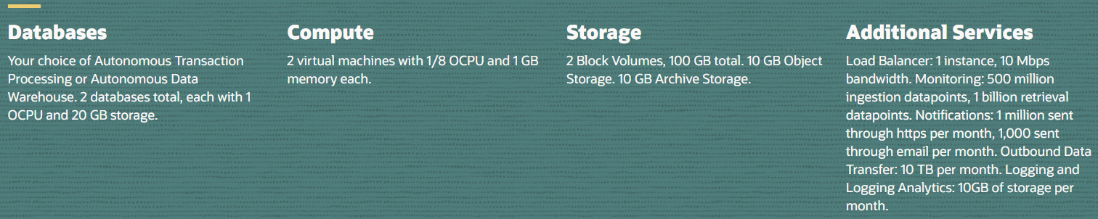
Oracle Cloud Infrastructure – Always Free Tier
Always Free Tier
Autonomous Database/Data Warehouse (two instances)
Compute VMs (two instances)
Block, Object and Archive Storage
Load Balancer and Data Egress
Monitoring and Notifications
Logging & Log Analytics
as of 25th October 2020

Slide 11
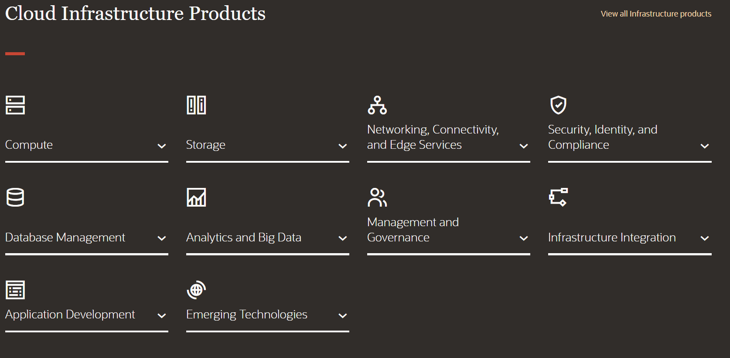
Introducing Oracle Cloud Infrastructure

Slide 12
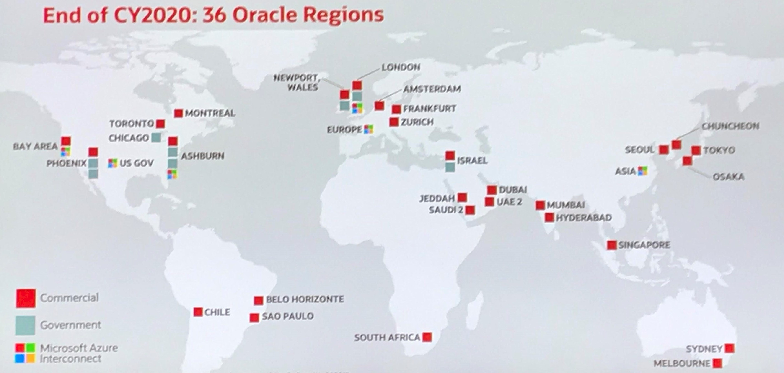

OCI Physical Organization
Regions have one or more Availability Domains
An AD lives in one or more Data Centers
ADs are isolated from each other – unlikely to fail together
ADs within a region have very fast, ultra-low latency interconnecting network backbone
Fault domains are isolated hardware clusters
With exclusive patch schedule
Each AD has three fault domains
Fault Domain
Data Center
Availability Domain
Region

Slide 13
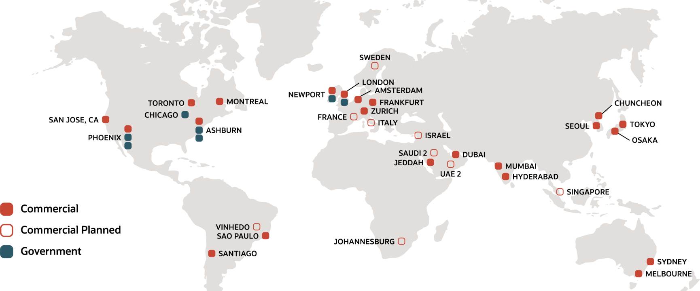
Oracle Cloud Infrastructure Regions – current and planned
Microsoft Interconnect Azure
source: oracle.com – April 2021

Slide 14




OCI Services for Cloud Native Application Development
Health Check
Monitoring
Logging
Alarms
Notifi-cations
API Gateway
Functions
Streaming
Digital Assistant
NoSQL Database
Object Storage
Visual Builder
OKE – Managed Kubernetes
Container
Container
OCIR
ID & Access
Management
Tagging
Compartments
API/Service
Events
Resource
Manager
Search
Compute

Slide 15

Health Check
Monitoring
Logging
Alarms
Notifi-cations
API Gateway
Functions
Streaming
Digital Assistant
NoSQL Database
Visual Builder
Object Storage
OKE – Managed Kubernetes
Container
Container
OCIR
ID & Access
Management
Tagging
Compartments
API/Service
Events
Resource
Manager
Search
Vault
Compute

Slide 16






DDoS Protection
WAF
Health Check
Monitoring
Logging
Alarms
Notifi-cations
API Gateway
Functions
Streaming
Digital Assistant
OKE – Managed Kubernetes
Container
Container
NoSQL Database
OCIR
Visual Builder
Object Storage
Compute
Virtual Machine
CI/CD & DevOps
Visual Builder Studio
Identity & Access
Management
Auditing
Tagging
Compartments
API/Service
Tagging
Compartments
API/Service
Search
Vault
Resource
Manager
Search
Cloud Guard
Events
Resource
Manager

Slide 17
Health Check
Monitoring
Logging
Alarms
Notifi-cations
API Gateway
Functions
Streaming
DDoS Protection
Digital Assistant
OKE – Managed Kubernetes
Container
WAF
Container
NoSQL Database
OCIR
Visual Builder
Object Storage
Compute
CI/CD & DevOps
Visual Builder Studio
Identity & Access
Management
API/Service
Auditing
Cloud Guard
Tagging
Compartments
Vault
Resource
Manager
Search

Slide 18









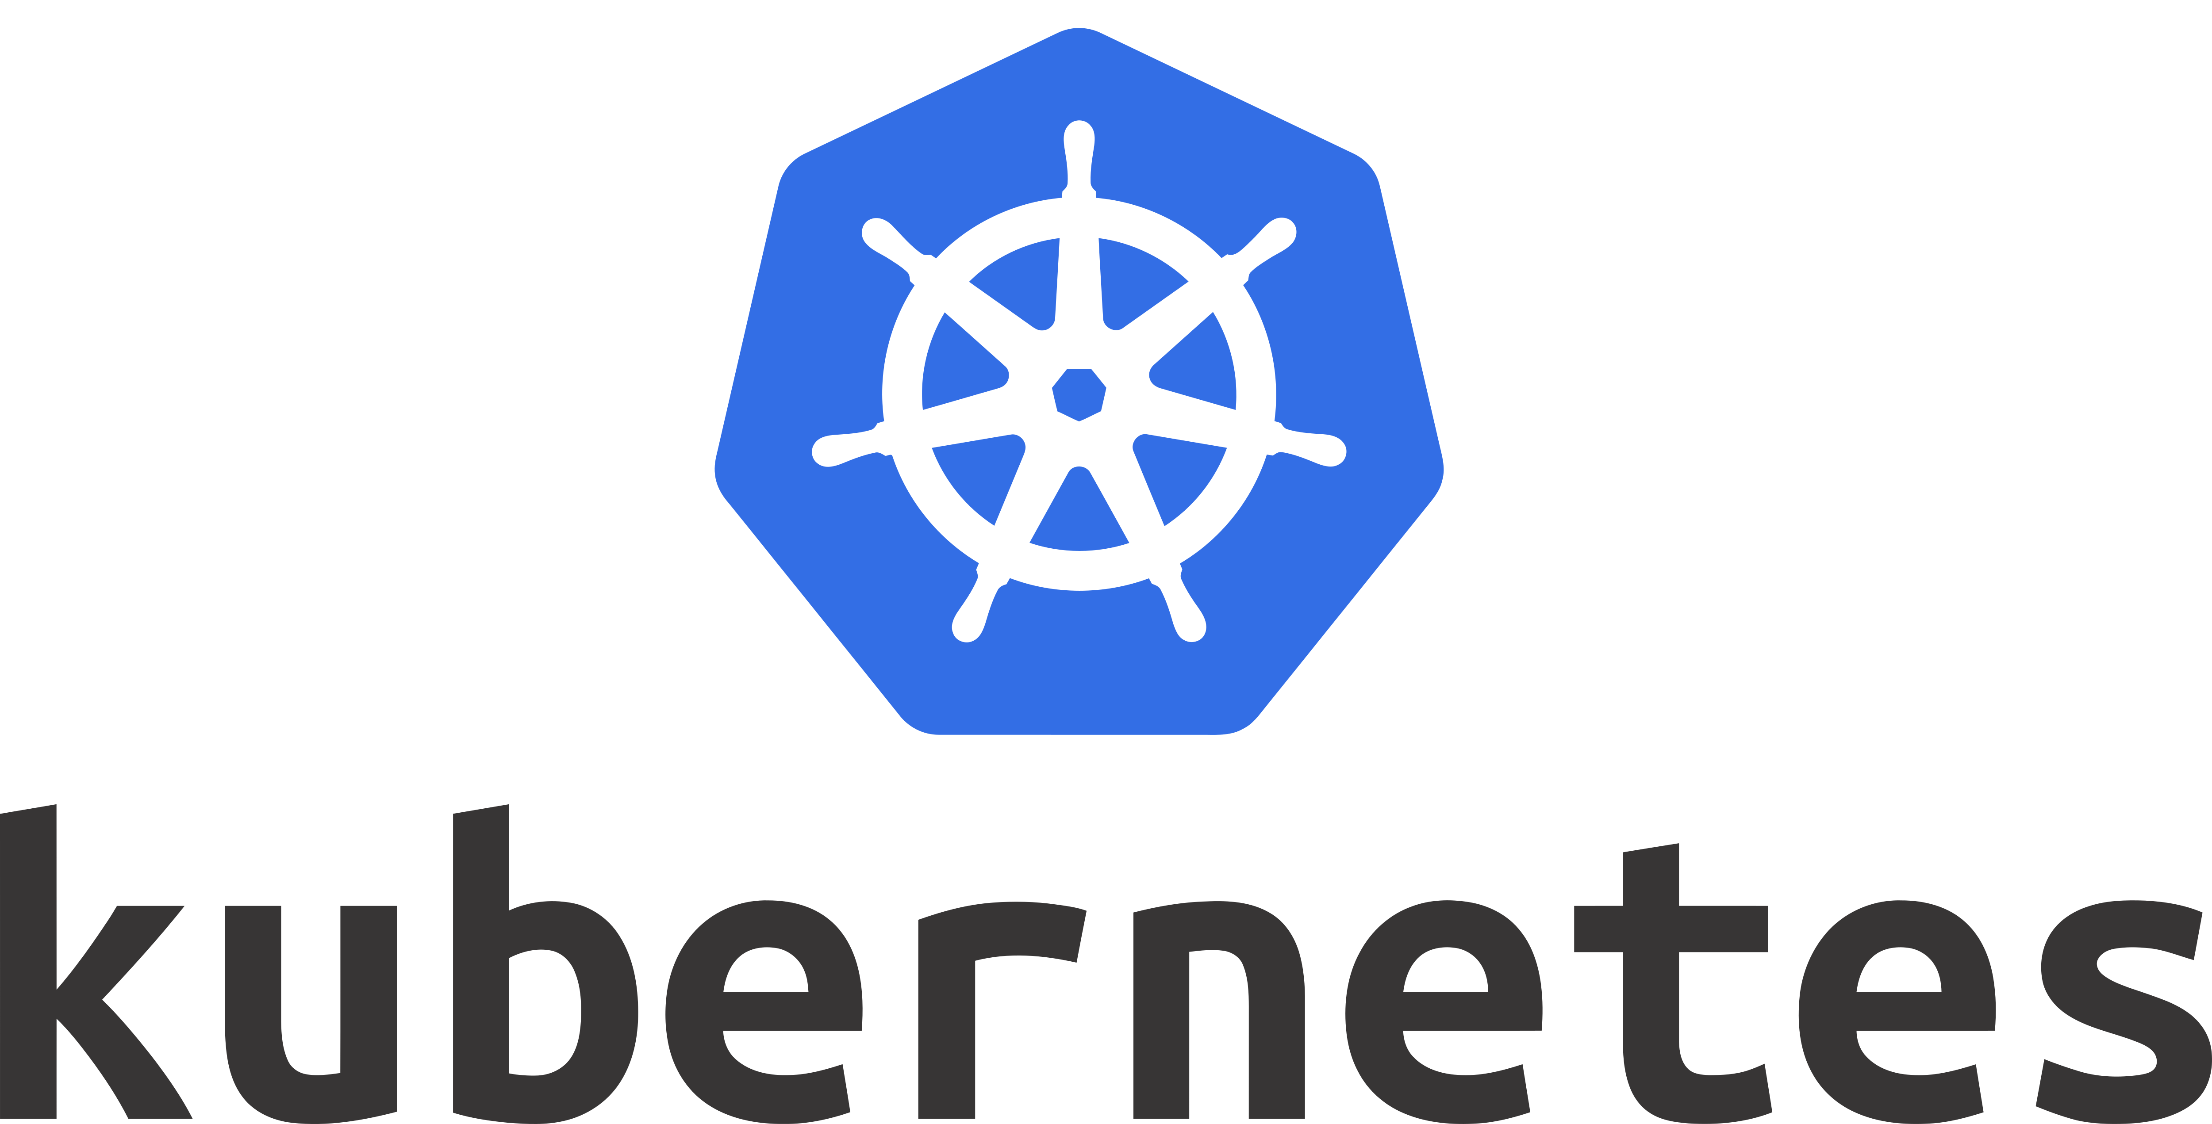
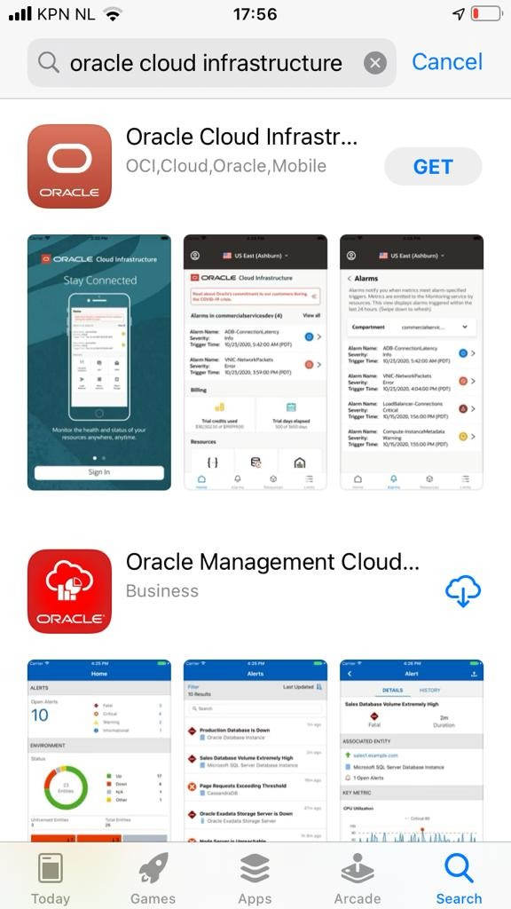





Health Check
Monitoring
Logging
Alarms
Notifi-cations
Healthcheck
Logging
API Gateway
Functions
Notifications
Telemetry/ Monitoring
Alarming
API Gateway
Streaming
DDoS Protection
Digital Assistant
Service Connector Hub
OKE – Managed Kubernetes
Streaming
Container
Functions
WAF
Container
NoSQL Database
Container
OCIR
Visual Builder
Container
Container Registry
Object Storage
Compute
Container Engine
For Kubernetes
Virtual Machine
Object Storage
CI/CD & DevOps
Events
Auditing
Visual Builder Studio
Identity & Access
Management
API/Service
Search
Vault
Cloud Guard
Tagging
Compartments
Vault
Resource
Manager

Slide 19
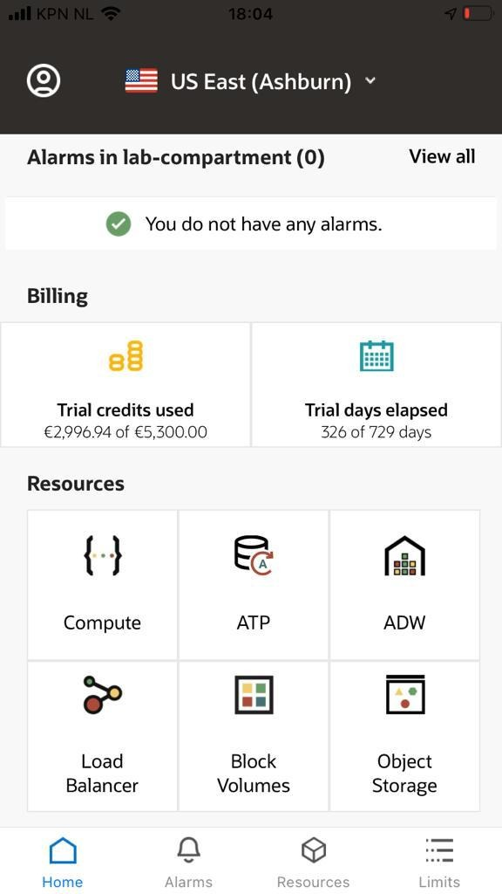
Tools
OCI Console – browser based GUI
OCI CLI
OCI SDKs – Java, Python, Ruby, Go, TypeScript
OCI REST APIs
Tools & Plugins
Visual Builder Studio – Automated CI/CD
Ansible Modules
Terraform Provider
Chef Knife Plugin
Oracle Developer Tools for VS Code
Toolkit for Eclipse
HDFS Connector
OCI Mobile App
OCI Cloud Tenancy

Slide 20
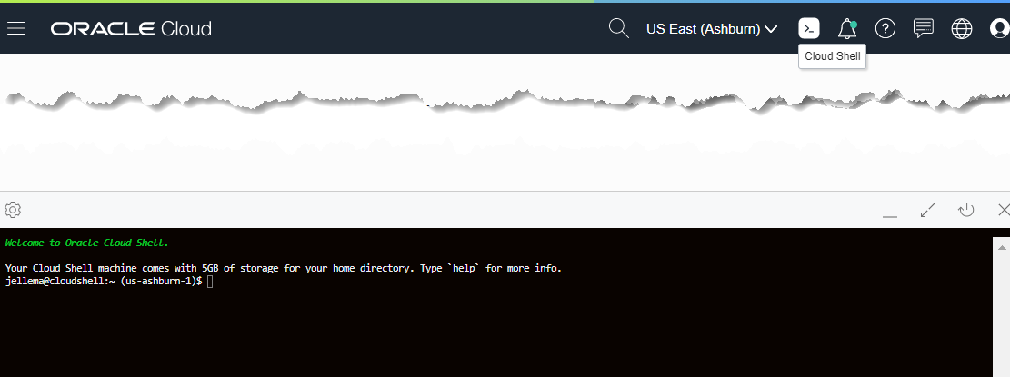



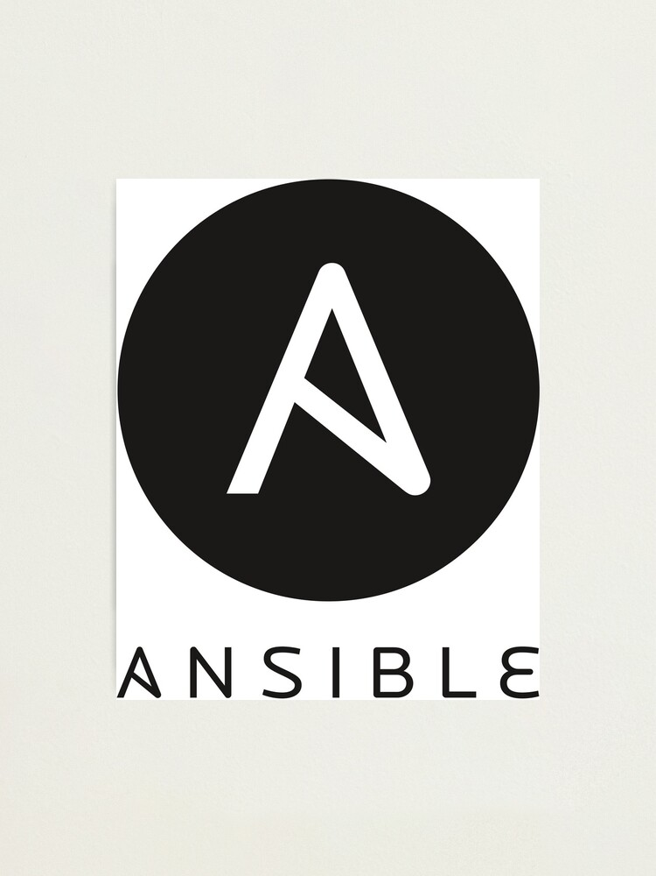







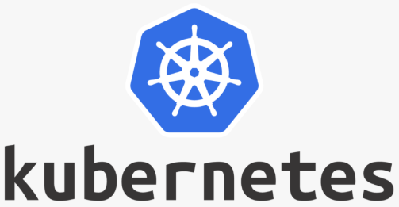







Cloud Shell
OCI Cloud Tenancy

Slide 21





Traditional Application: Tweets to NoSQL, Streaming & Email
Function
Object Storage
Function
Events
Notifications
NoSQL Database
API Gateway
Healthcheck
Streaming
#ukoug2021

Slide 22
Traditional Application: Tweets to NoSQL, Streaming & Email
A single unit to build | test | deploy | scale | fail
Synchronous (internal) interactions
No (built-in) monitoring | logging
API
WebApp
3rd party libraries & frameworks
log
Database (RDBMS?)
Java EE
JVM
NoSQL Database
Streaming
#ukoug2021
Operating System
Platform and Infrastructure to install | configure | secure | operate | maintain
Hardware
Logging?
Monitoring?

Slide 23
Demonstration of Cloud Native Application on OCI: Tweets to NoSQL, Streaming & Email
Function
Object Storage
Function
Events
Notifications
NoSQL Database
API Gateway
Healthcheck
Streaming
#ukoug2021

Slide 24


Cloud Native design Tweets to NoSQL, Streaming & Email
Store JSON file with all tweets in time period
Cloud Event for new JSON file
Create Tweet Records in NoSQL
Trigger function with event
Invoke Tweet Aggregator every X minutes
NoSQL Database
Function
Publish to Notification Topic
Expose function to external callers
Object Storage
Healthcheck
Write JSON document with Tweets
Custom code in multiple small units that each build | test | deploy | scale | fail
Asynchronous interactions
Managed Platform (and underlying Infra) with built in logging | monitoring | Ops Configured through Infra as Code
API Gateway
Streaming
Events
Publish each Tweet to Stream
Function
Retrieve X minutes worth of tweets
Notifications
Send Tweet Report as email
Get Twitter credentials in secure way from vault
Vault
Logging
Container Registry
Monitoring
#ukoug2021
Auditing

Slide 25



Serverless Functions
No IaaS
apart from a little network and picking memory/CPU shapes
no knowledge, time spent, money wasted
no dedicated infrastructure (and costs) – fit for high watermark load
Functions runs & scales as & when required [without admin intervention]
Easy to automate build, deployment, configuration, management
Out of the Box – Native Cloud mechanisms
IAM, Logging, Monitoring, Configuration Management, OCI integration
API Gateway – expose, shield, enforce TLS and authorization, throttle, validate, transformation, response cache
Asynchronous interaction design thinking - trigger and be triggered
Small(ish), stateless, comprehensible
Open
Start quickly, start cheaply and start easily

Slide 26
Decoupling
Encapsulation (of implementation)
Run time availability independence
Independent release / reconfigure
Independence of scaling
Volume Load Throttling/Absorption
Security Boundary
Failure isolation
NoSQL Database
Function
Object Storage
API Gateway
Streaming
Events
Function
Notification Topic
Vault
Logging
Container Registry
Monitoring
#ukoug2021
Auditing

Slide 27
Platform Preparation – Infrastructure as Code using Resource Manager & Terraform plan
Function
Events
Notifications
Virtual Cloud Network with private and public subnet and access from and to public internet
Object Storage Bucket
API Gateway
NoSQL Database Table for persisting records
Healthcheck
Object Storage
Stream for publishing messages to
Skeleton API Gateway for deploying API routing rules to
Route Table
API Gateway
Internet Gateway
Security Lists
Dynamic Groups for API Gateway and for Functions
Virtual Cloud
Network
Streaming
Configuration of Logging Service for Functions
Compartment for Application resources
Groups
Secure Vault with Keys for Twitter credentials
Vault
Logging
Resource
Manager
Compartments
Container Registry
Auditing

Slide 28
Serverless Function & Object Storage
Function
Events
Notifications
Store JSON file with all tweets in time period
API Gateway
Healthcheck
Object Storage
Write JSON document with Tweets
Retrieve X minutes worth of tweets
Function
Tweet Summarizer
Function
Container Image Registry
Central Logging Service
Get Twitter credentials in secure way from vault
Vault
Logging
Container Registry
#ukoug2021
Auditing

Slide 29


Introducing Serverless Functions
The Container Native Serverless Framwork
Project Fn is an open source FaaS platform that you can run anywhere -- any cloud or on-premise.
It implements serverless Functions through Docker containers
Out of the box support for many runtimes
also support for custom Docker Container (white box)
Project Fn is the foundation for Serverless Functions on OCI

Slide 30
Fn Functions – request handling
With method, headers, query parameters, url path, body
Function as a Service framework
FDK
HTTP Request
Function Implementation (Node, Java, Go, Python, custom Docker, …)
input – derived from body
ctx – raw HTTP request components

Slide 31
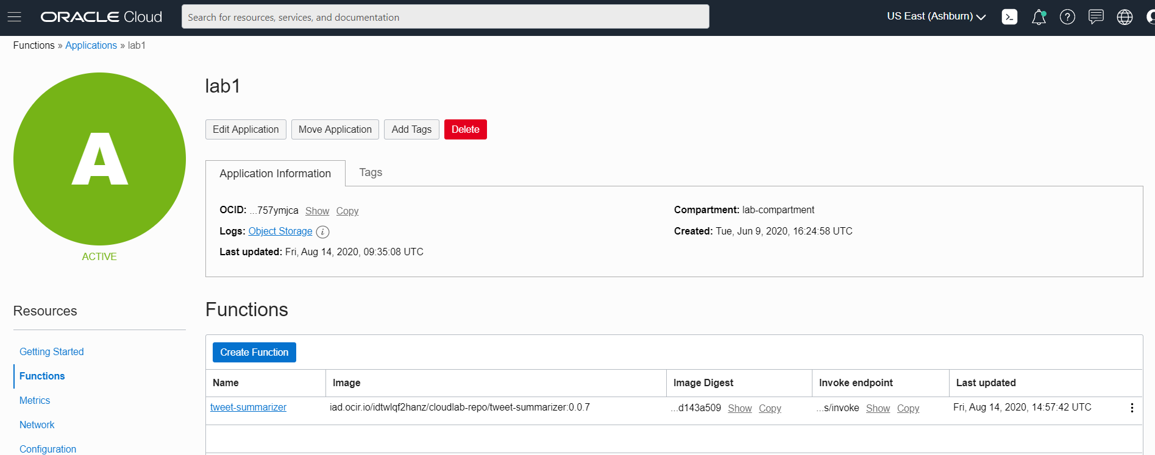
Function tweet-summarizer in application lab1

Slide 32
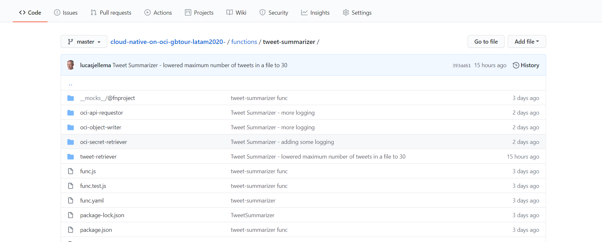

Function tweet-summarizer – source code in GitHub
Sources: https://github.com/lucasjellema/cloud-native-applications-on-oci-ogb-apacouc-2020

Slide 33
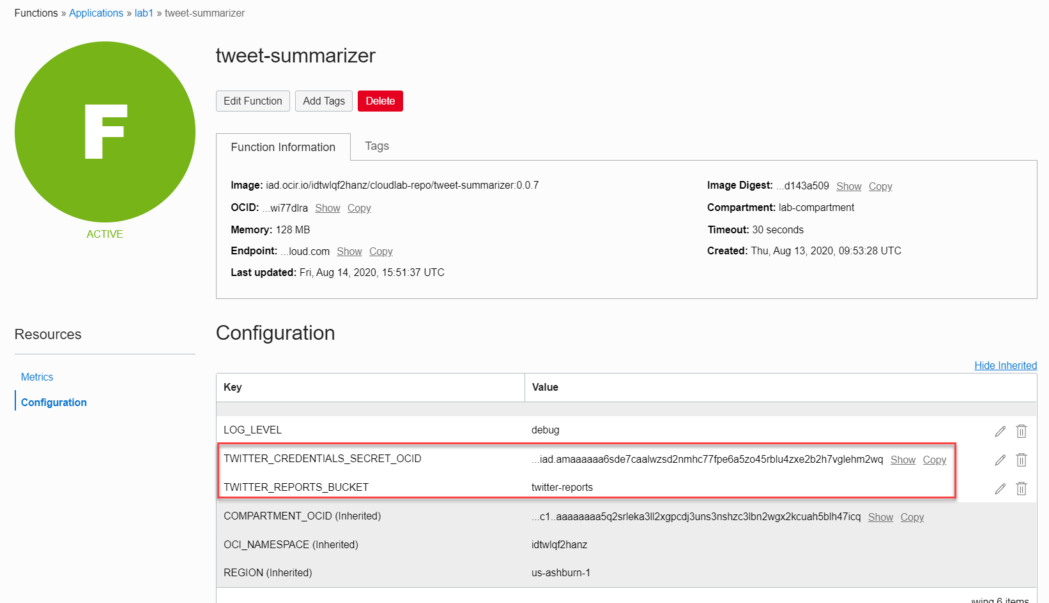
Configuration Settings for Function tweet-summarizer result in environment variables accessible within the function
Vault

Slide 34
Application Design
Function
Events
Notifications
Store JSON file with all tweets in time period
API Gateway
Healthcheck
Object Storage
Write JSON document with Tweets
Retrieve X minutes worth of tweets
Function
Tweet Summarizer
Function
Container Image Registry
Central Logging Service
Get Twitter credentials in secure way from vault
Vault
Logging
Container Registry
#ukoug2021

Slide 35
Functions vs Containers vs VMs
Functions
Containers on OKE
VMs
Functions
Serverless
No IaaS DevOpS
Stepless Pay per use
Free-Tier
Auto-Scale
Automatic Fail Over
Integration with OCI
Triggered by OCI
Call OCI services
Leverage OCI for Audit, Log, Monitor
Restricted, simple programming model
Short running
Container Engine
For Kubernetes
Serverless runtime
Initial IaaS Setup
Pay per VM, scale per VM
Auto-Scale by K8S
Some auto Fail Over
Little integration with OCI
Kubernetes for Ops
Flexible programming model – any container goes
Virtual Machine
Fully Servered
DIY IaaS Op
Pay per VM, scale per VM, cheap at large scale
Manual Scaling
Manual Fail Over
Little integration with OCI
Flexible programming model

Slide 36
Application Design
Function
Events
Notifications
Store JSON file with all tweets in time period
API Gateway
Healthcheck
Object Storage
Write JSON document with Tweets
Function
Tweet Summarizer
Retrieve X minutes worth of tweets
Function
Get Twitter credentials in secure way from vault
Vault
#ukoug2021

Slide 37
Application Design
Function
Events
Notifications
Signed HTTP call to OCI REST API
API Gateway
Object Storage
Healthcheck
Tweet Summarizer
Write JSON document (to OCI Object Storage)
Retrieve selected Tweets from Twitter API
Function
Retrieve Twitter API Credentials (from Secret in OCI Vault)
Signed HTTP call to OCI REST API
Vault

Slide 38
Application Design
Function
Events
Notifications
Twitter API
Tweet Summarizer
Retrieve selected Tweets from Twitter API
API Gateway
Healthcheck
Retrieve Twitter API Credentials (from Secret in OCI Vault)
Coordinate actions
Vault
OCI API
Vault Service
Make signed HTTP call to OCI REST API
Write JSON document (to OCI Object Storage)
Object Storage
OCI API
Object Storage Service

Slide 39
Application Design
Function
Events
Notifications
Twitter API
Tweet Summarizer
Retrieve selected Tweets from Twitter API
API Gateway
Healthcheck
Retrieve Twitter API Credentials (from Secret in OCI Vault)
Project Fn FDK Adapter
Coordinate actions
Vault
OCI API
Vault Service
Make signed HTTP call to OCI REST API
Write JSON document (to OCI Object Storage)
Object Storage
OCI API
Object Storage Service

Slide 40
Tweet Summarizer
ENV: TWITTER_CREDENTIALS_FILE
TWITTER_CREDENTIALS_SECRET_OCID
Twitter API
ENV: TWITTER_REPORTS_BUCKET
tweet-retriever.js
func.js
tweet-summarizer.js
ENV: OCI_RESOURCE_PRINCIPAL_PRIVATE_PEM , OCI_RESOURCE_PRINCIPAL_RPST, PRIVATE_KEY_FILE, KEY_FINGERPRINT
, TENANCY_ID, USER_ID
twit
oci-secret-retriever.js
OCI API
Vault Service
fnproject@fdk
oci-api-requestor.js
url
ENV: REGION, COMPARTMENT_OCID
https
oci-object-writer.js
fs
OCI API
Object Storage Service
ENV: REGION, OCI_NAMESPACE

Slide 41
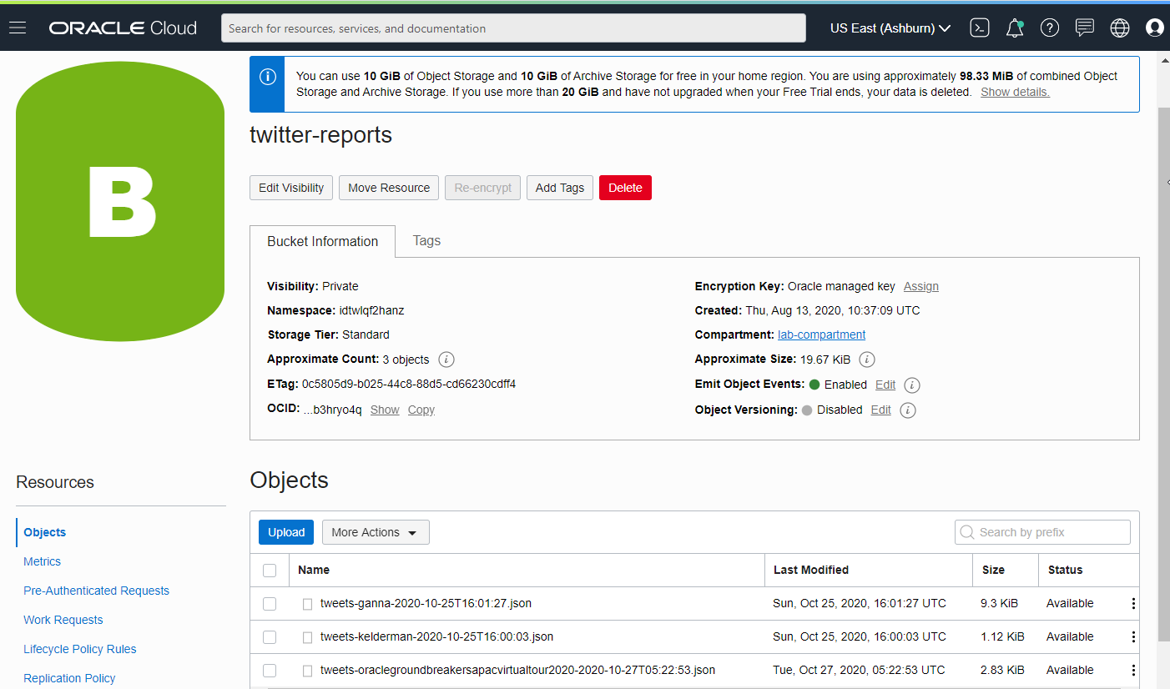
Object Storage – Bucket for twitter reports

Slide 42
Serverless Function & Object Storage
Function
Events
Notifications
Store JSON file with all tweets in time period
API Gateway
Healthcheck
Object Storage
Write JSON document with Tweets
Retrieve X minutes worth of tweets
Function
Tweet Summarizer
Get Twitter credentials in secure way from vault
Vault
Logging
Container Registry
#ukoug2021

Slide 43


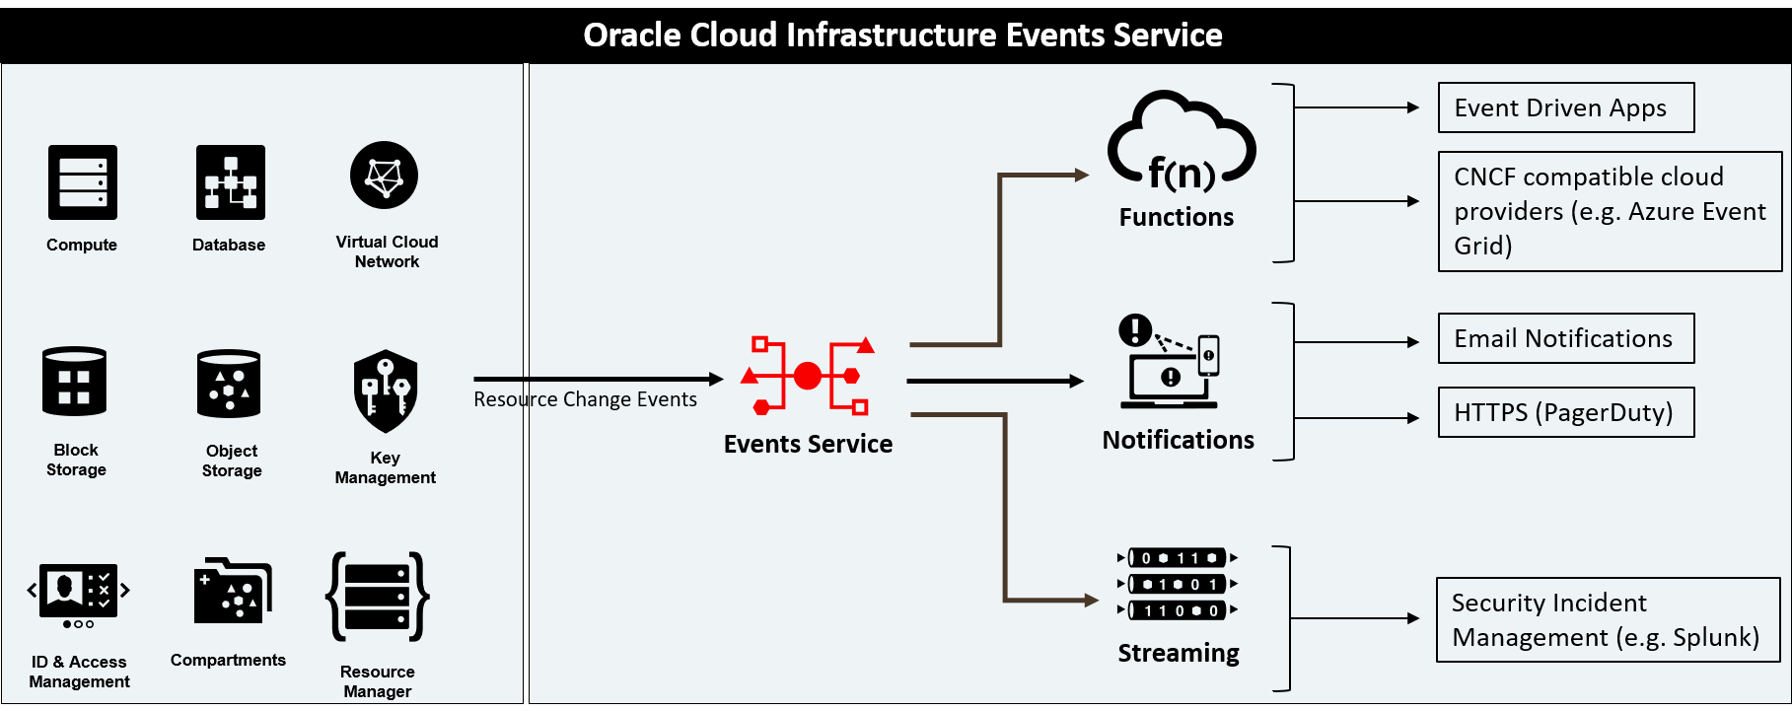



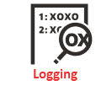


Function execution is triggered by
Any HTTP request
Authenticated, Signed HTTP request
API Gateway
Healthcheck
Functions
Events
Notifications
Alarming
Resource
Manager
Service Connector
Streaming

Slide 44
Function execution is triggered by
Ops automation
App
Any HTTP request
Authenticated, Signed HTTP request
Application
App
Ops
API Gateway
Healthcheck
Ops
Functions
Events
App
Ops
Ops
Notifications
Ops
Alarming
Alarming
Ops
Resource
Manager
Service Connector
Streaming

Slide 45
Public and Managed Access to Function Tweet Summarizer
Function
Events
Notifications
Healthcheck
Object Storage
Expose function to external callers
API Gateway
Function
Tweet Summarizer
Function
Container Image Registry
Central Logging Service
Vault
Logging
Container Registry
#ukoug2021

Slide 46
API Gateway
Expose private endpoints publicly
Stable (public) endpoints
Routing (verb & wildcard based)
Parameter and Header mapping
Request Policies
Rate limiting (per client & general)
CORS (for direct web client access)
Metrics Monitoring & Logging
Authentication & Validation
Cache & reuse Responses
Transform headers & parameters in requests & headers in responses
Handle HTTP calls:
Authorize
Validate
Throttle
Route
(respond from) Cache
Map
Transform
Observer
Monitor
Audit
Log
Function
Any Service Invoker
API Gateway
Stock
API Gateway
Any 3rd party HTTP endpoint
VM
Any HTTP Endpoint on OCI
OKE
OIC
…
Logging
Monitoring
Auditing
Oracle Cloud Infrastructure

Slide 47
API Gateway Authorizer Function
Authorizer Function can be configured on Route or on API Deployment
Any backend – HTTP destination, Oracle Function, Stock Response – can be subject to an authorizer function
Invoke API, provide token in header
JSON returned by Authorizer Function is embedded in request to backend
Any Service Invoker
API deployment
/path
Any backend
API Gateway
API Gateway
API Gateway
Authorizer Function
Authorizer Function that allows or denies access based on Header [Token]
Oracle Cloud Infrastructure

Slide 48
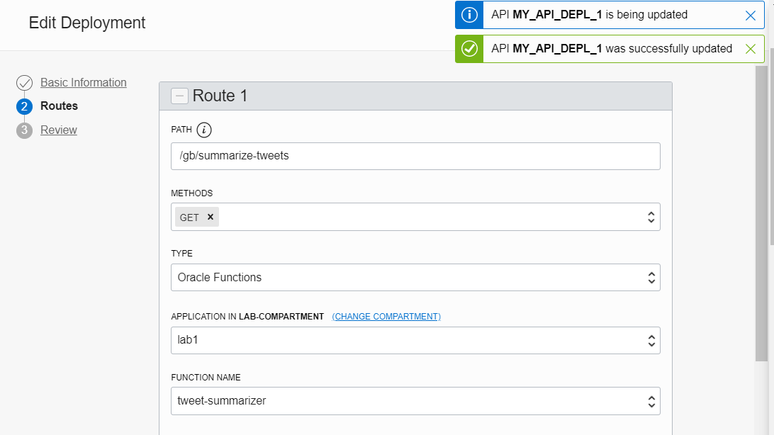
API Gateway Configuration for public access to Function
Notes:
https://a7otzunjmey252aivwp2gfhrfq.apigateway.us-ashburn-1.oci.customer-oci.com/my-depl1/gb/summarize-tweets?hashtag=ganna&minutes=17

Slide 49




Leverage OCI PaaS Services and Facilities from Functions
Streaming
synchronous
NoSQL Database
API Gateway
Object Storage
Functions
asynchronous
Autonomous Database
Notifications
Email Delivery
Autonomous JSON
Logging
Monitoring
Auditing
Vault

Slide 50
Trigger
Function
Events
Notifications
Healthcheck
Object Storage
Expose function to external callers
API Gateway
Function
Tweet Summarizer
Function
Vault
#ukoug2021

Slide 51
[how to] Trigger Email Notification
Function
Events
Notifications
?
Healthcheck
Object Storage
Expose function to external callers
API Gateway
Function
Tweet Summarizer
Function
Send Tweet Report as email (or SMS or Slack message)
Vault
#ukoug2021

Slide 52

Produce CloudEvent, Publish Notification & Send Mail
Function
Cloud Event for new JSON file on Object Storage
Publish to Notification Topic
Healthcheck
Object Storage
API Gateway
Events
Notifications
Function
Send Tweet Report as email (or SMS or Slack message)
Service Connector Hub
Streaming
Vault
New alternative (as of April 2021) for high volumes
#ukoug2021

Slide 53
EVENTS and NOTIFICATIONS SERVICES

Slide 54
Events identified and turned to Notification Events to be Published and Routed
Pager Duty
Slack
Functions
Alarming
Web Hook
Event
OCI Resource
Cloud Event
Event
Email
Cloud Event
Notifications
Event
Event Rules
Notification
Topic
Functions
Subscriptions
Event
Streaming
Functions
Streaming

Slide 55
THE BASICS FOR THESE TWO SERVICES ARE…
EVENTS SERVICES
NOTIFICATION SERVICES
Event
OCI Resource
Cloud Event
Event
Email
Notifications
Event
Event Rules
Notification
Topic
Functions
Event
Streaming

Slide 56
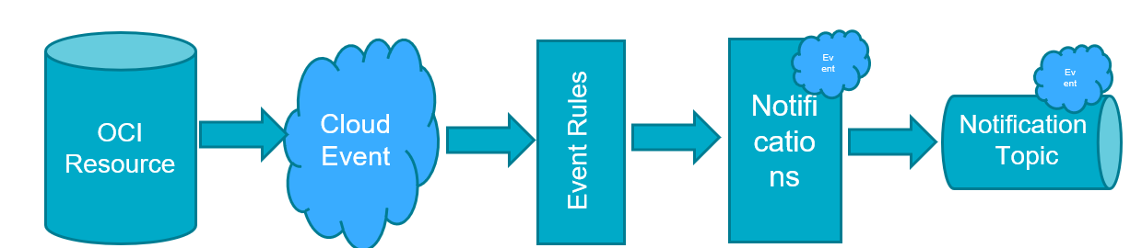
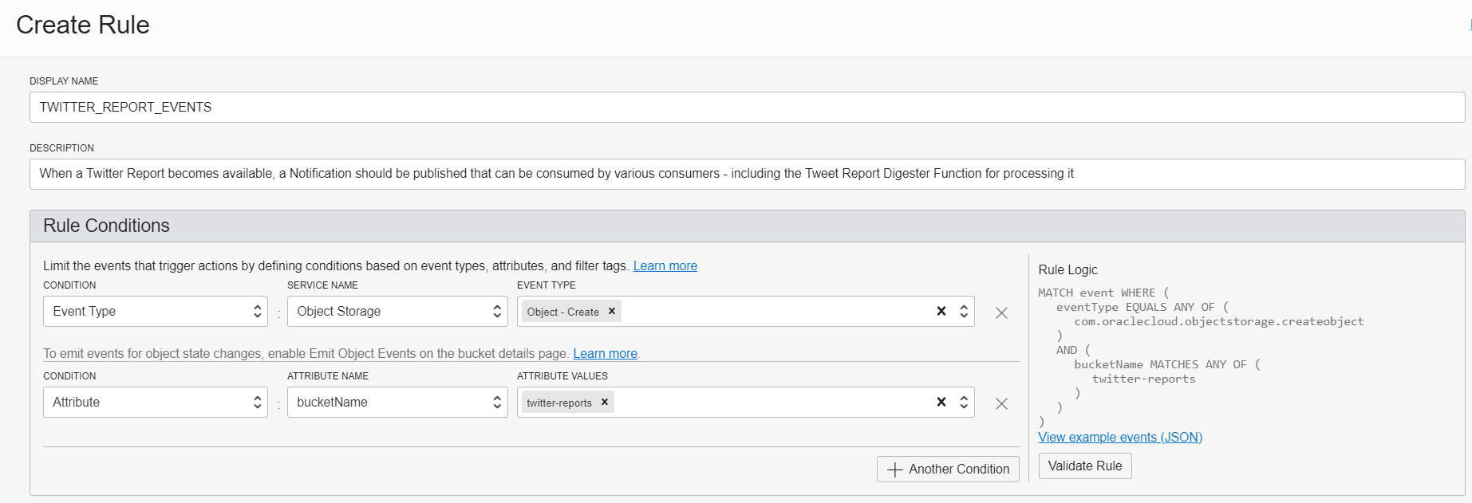
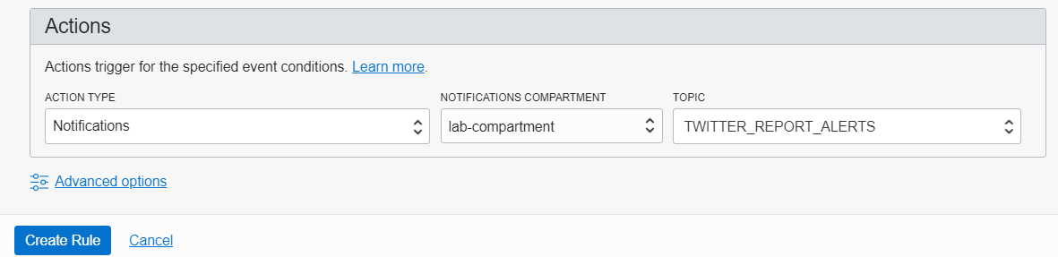
Configure Event Rule Notification triplet
Cloud Event
Event Rules
OCI Resource
Notifications
Notification
Topic

Slide 57
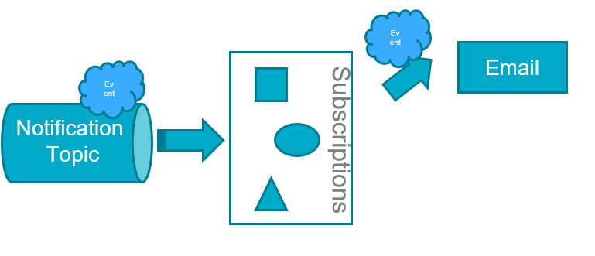
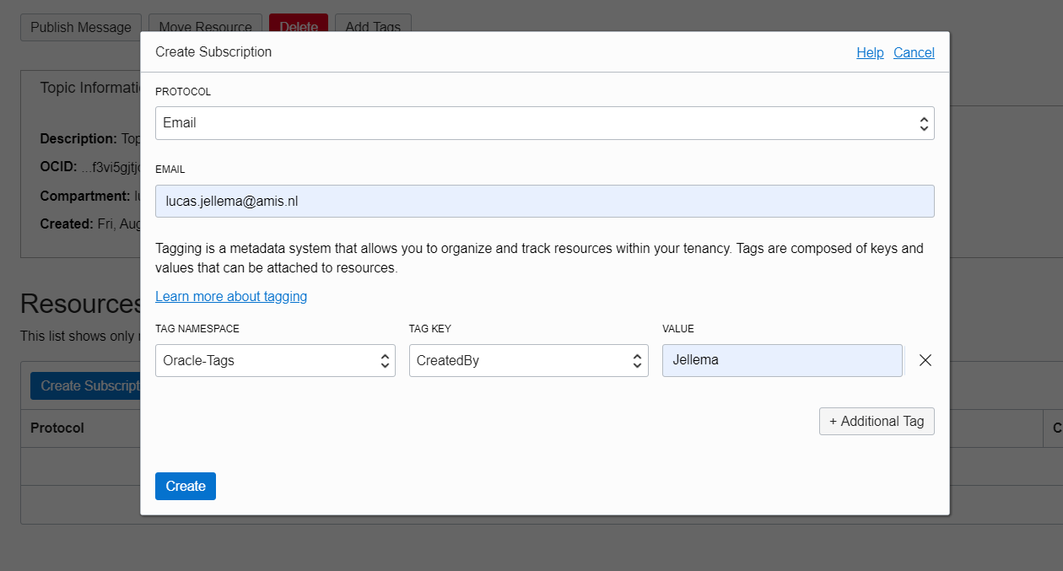
Send email upon Notification

Slide 58
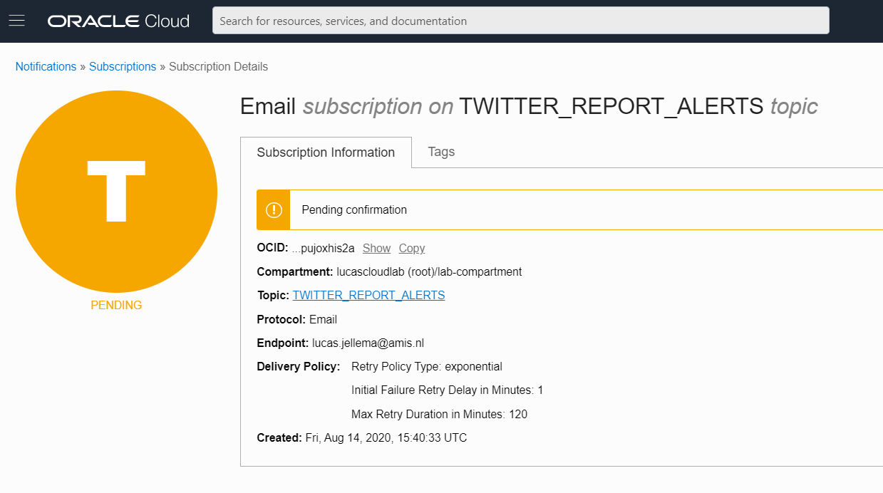
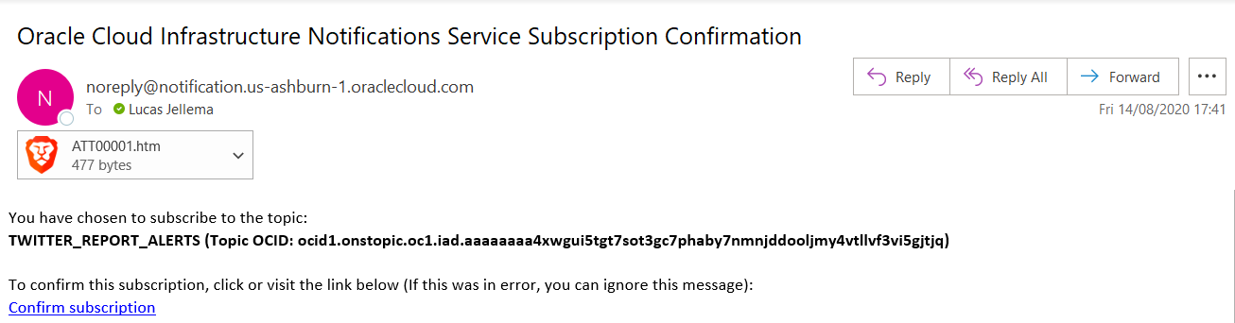
Email Subscription is Pending until confirmed

Slide 59
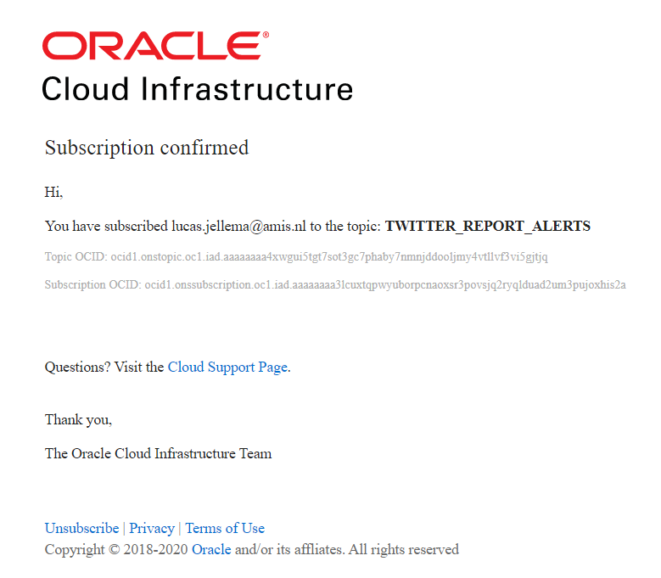
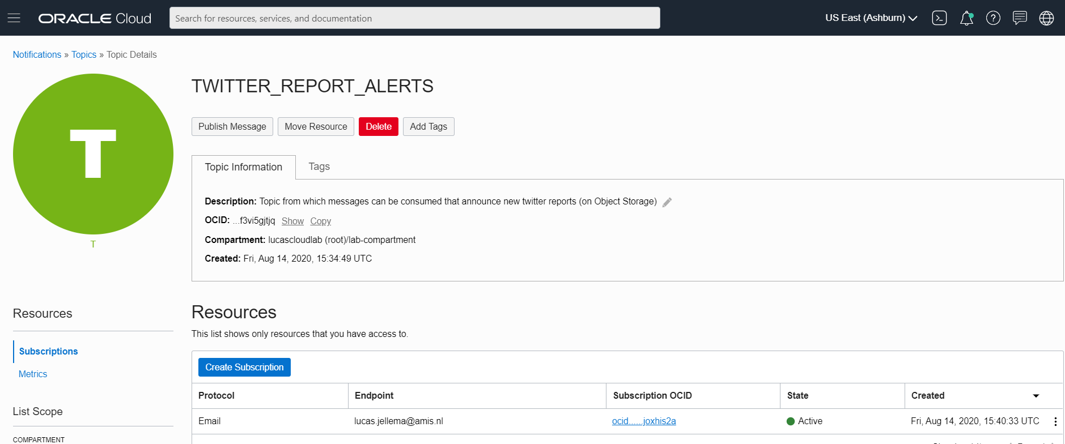
When confirmed, the subscription is active

Slide 60
When the Tweet Summarizer is invoked…
Object Storage
API Gateway
Events
Notifications
Function
Vault
Oracle Groundbreakers Tour 2020 LATAM | Oracle Cloud Native Application Development

Slide 61
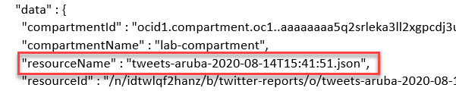
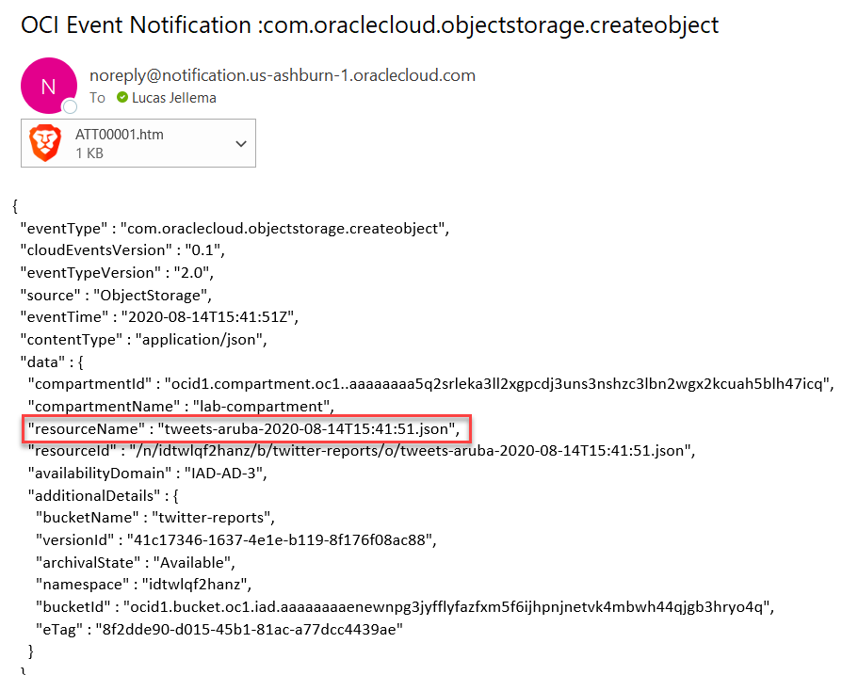
… the email informs of the new file
Object Storage
API Gateway
Events
Notifications
Function
Vault
Oracle Groundbreakers Tour 2020 LATAM | Oracle Cloud Native Application Development

Slide 62
Produce CloudEvent & Publish Notification
Function
Cloud Event for new JSON file
Publish to Notification Topic
Healthcheck
Object Storage
API Gateway
Events
Notifications
Function
Send Tweet Report as email
Vault
#ukoug2021

Slide 63
Trigger Function & Store NoSQL Records
Retrieve Tweet Report
Create Tweet Records in NoSQL
NoSQL Database
Function
Healthcheck
Object Storage
Trigger function with event
API Gateway
Events
Notifications
Function
Vault
#ukoug2021

Slide 64

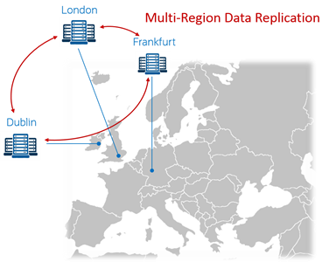
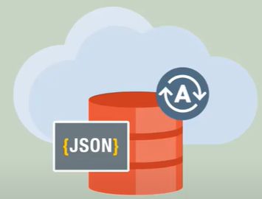
Introducing NoSQL Database Cloud Service
Launched in February 2020 – a fully managed cloud service
Based on Oracle NoSQL Database
Which itself is based on Berkeley DB as storage engine
Schemaless JSON and SQL enabled on relational data
ACID, consistent, relational, structured, joins
Partial JSON Updates
Server-side updates to JSON documents
Time-To-Live – auto-expire on records
Built-in Data Redundancy
Multi-region architecture
read-anywhere/write-anywhere in “WAN” cluster
REST APIs, OCI CLI and SDKs in Java, Python, Node and Go
NoSQL Database Cloud Simulator for local development and testing
Note: August 13th 2020 – launch of “Autonomous JSON Database

Slide 65
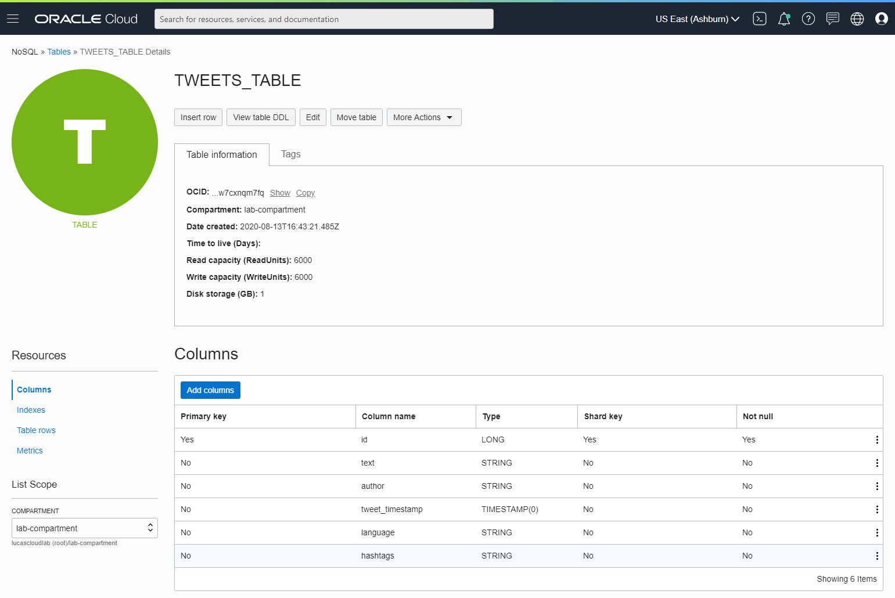
NoSQL Database Table TWEETS_TABLE

Slide 66
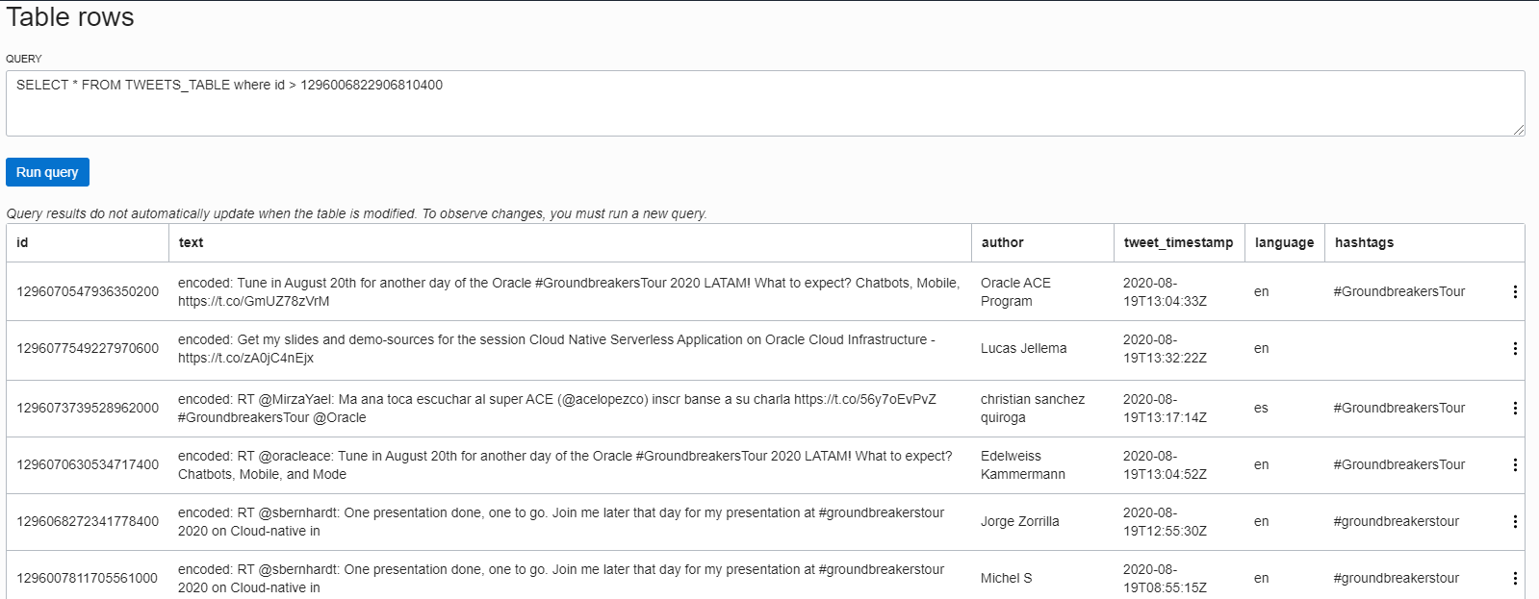
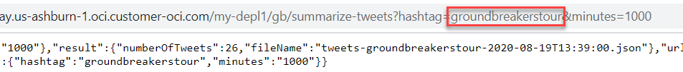
Tweet Records in TWEETS_TABLE

Slide 67
Trigger Function & Store NoSQL Records
Retrieve Tweet Report
Create Tweet Records in NoSQL
Trigger function with event
NoSQL Database
Function
Healthcheck
Object Storage
API Gateway
Events
Notifications
Function
Vault
#ukoug2021

Slide 68
Stream records
NoSQL Database
Function
Healthcheck
Object Storage
API Gateway
Events
Streaming
Notifications
Publish each Tweet to Stream
Function
Vault
#ukoug2021

Slide 69
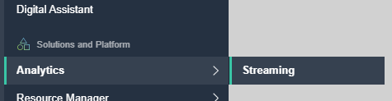
OCI Streaming Service
Kafka-like – Event Queue
Support for partitions and consumer groups
Events are Published and Consumed through REST API calls
Java SDK available
“Connections” are stateless
No Push to Consumer!
Consumer has to poll
Or: stream messages through Service Connector Hub to target consumer
Oracle Cloud Infrastructure
OCI Streaming
Stream
Consumer
Publisher
Service Connector Hub
Consumer
Consumer
3rd Party Cloud
Object Storage
Notifications
Monitoring
Functions
Streaming
On prem

Slide 70
OCI Streaming Service
Message retrieval is done through a “Cursor”
Similar to a (long running) query
Cursor indicates where to read from Stream
Earliest, latest, at offset, from offset, from time
No Filter to apply upon reading
Message Retention: 7 days
Max throughput: 1 MB/s
Max message size: 1 MB
Oracle Cloud Infrastructure
cursor
OCI Streaming
Stream
Consumer
Publisher
Service Connector Hub
Consumer
Consumer
3rd Party Cloud
Object Storage
Notifications
Monitoring
Functions
Streaming
On prem

Slide 71
(Cloud) Events can be published to Stream directly
Streaming

Slide 72
Stream records
NoSQL Database
Function
Healthcheck
Object Storage
API Gateway
Events
Streaming
Notifications
Publish each Tweet to Stream
Function
Vault
#ukoug2021

Slide 73
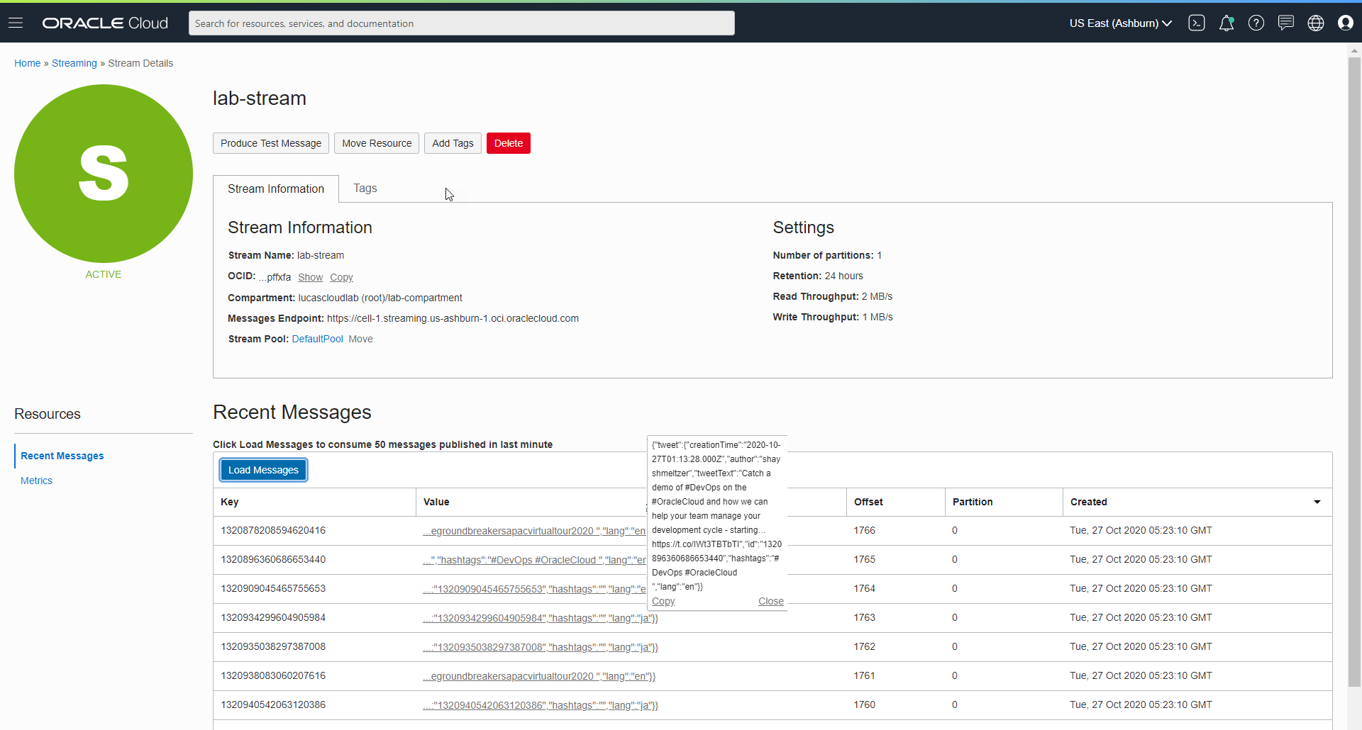
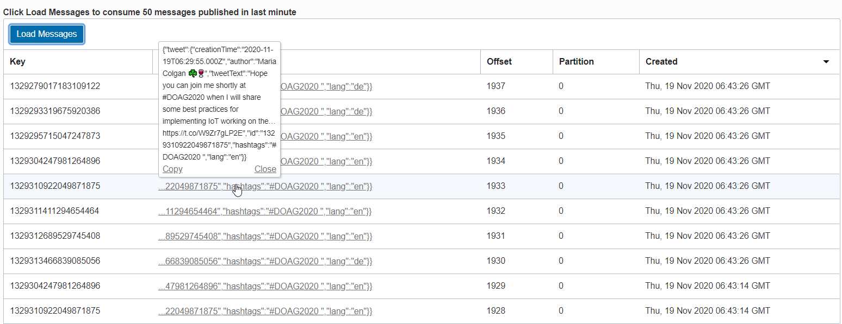
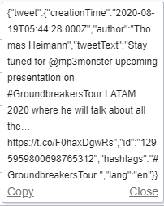
Tweet Messages Published by Function consumed from the Stream

Slide 74
Schedule Function for periodic execution
NoSQL Database
Function
Invoke Tweet Aggregator every X minutes
Object Storage
API Gateway
Events
Healthcheck
Streaming
Notifications
Function
Vault
#ukoug2021

Slide 75
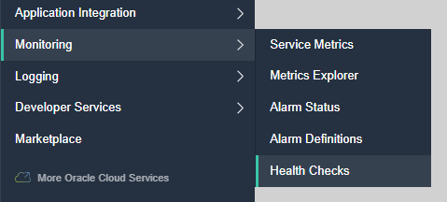


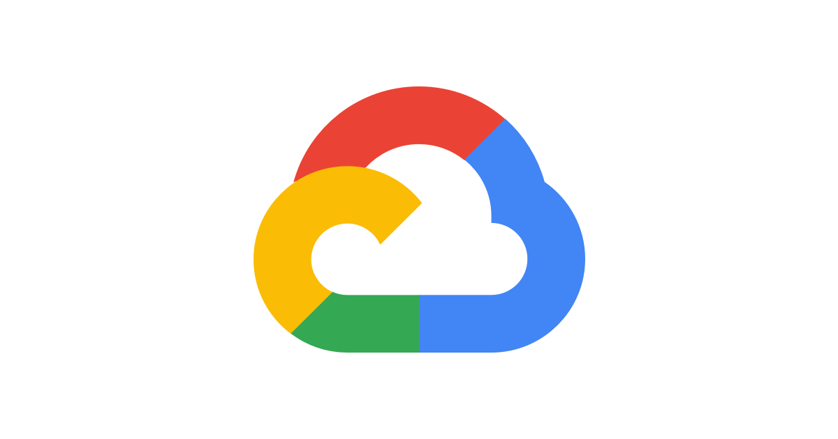


Monitoring | Health Checks
Verify through the eyes of an external client if endpoints are available and respond quick and well
Periodic or Adhoc call to an endpoint
HTTP(S) or Ping
Specify Headers
Specify Interval (check frequency)
From selected Vantage Points
3rd party clouds, geographic locations around the world
Health Check results can be inspected through the Monitor in the Console
Use health checks for live function smoke tests
API Gateway
Functions
Healthcheck

Slide 76
[tricks for] Scheduling Functions
OCI does not currently have a way to schedule jobs
Health Checks are scheduled, periodic HTTP(S) requests
Once every 30 | 60 seconds or 5 | 10 | 15 minutes
Monitoring Alarms are evaluated and repeated on the indicated specific interval
Define an Alarm that will be triggered; set repeat interval at desired function execution interval
Monitoring
Alarming
API Gateway
Functions
Notifications
Healthcheck
CRON expression passed as header or parameter in healthcheck configuration
Configuration Parameters
When triggered evaluate CRON expression and decide whether to run
CRON expression to run once every hour | day | Sunday | …

Slide 77
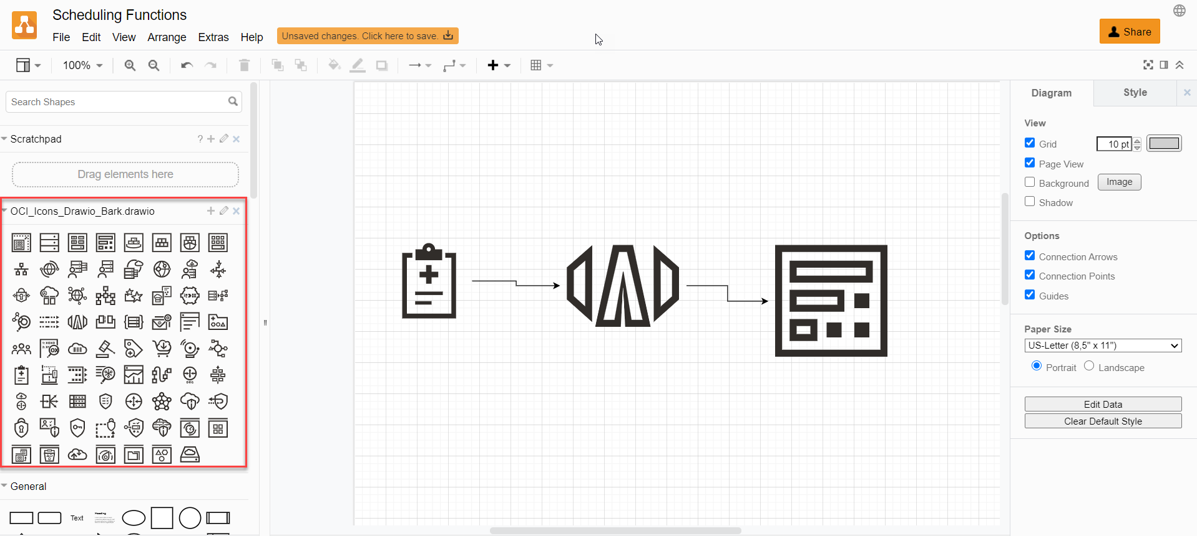
Drawing OCI Solution Designs on diagrams.net (fka draw.io)
Download draw.io graphics from https://docs.cloud.oracle.com/en-us/iaas/Content/General/Reference/graphicsfordiagrams.htm… , unzip and upload as library to draw.io

Slide 78
Summary
Cloud Native: Pay per use/TCO
NoSQL Database
DDoS Protection
Function
Object Storage
WAF
API Gateway
Events
Streaming
Notifications
Function
Cloud Guard
Healthcheck
Identity & Access
Management
Email Delivery
Vault
Compartments
Logging
Container Registry
Monitoring
#ukoug2021
Auditing

Slide 79





Pay per use
NoSQL Database
Function
Object Storage
API Gateway
Events
Streaming
Function
Notifications
Healthcheck
Cloud Guard
Identity & Access
Management
Email Delivery
Vault
Compartments
Logging
Container Registry
Monitoring
Auditing
First X
Free
Always Free
Tier
Low unit
price
Elastic Pricing

Slide 80
Summary
Cloud Native: Pay per use/TCO
NoSQL Database
DDoS Protection
Function
Object Storage
WAF
API Gateway
Events
Streaming
Notifications
Function
Cloud Guard
Healthcheck
Identity & Access
Management
Email Delivery
Vault
Compartments
Logging
Container Registry
Monitoring
#ukoug2021
Auditing

Slide 81
Summary
Cloud Native: Platform Services
Managed => Serverless
Quick Provision & Decommission
Distributed
Automated
Pay per use/TCO
Vendor takes runtime responsibility
Enterprise grade platform for all Security & Availability
Scale
Ops facilities (monitor, log, audit, events, failover)
Rapid Innovation (new services, new features, new pricing)
NoSQL Database
DDoS Protection
Function
Object Storage
WAF
API Gateway
Events
Streaming
Notifications
Function
Cloud Guard
Healthcheck
Identity & Access
Management
Email Delivery
Vault
Compartments
Logging
Container Registry
Monitoring
#ukoug2021
Auditing

Slide 82
Constant Evolution on OCI
Since mid June 2020
Export Compartment as Terraform plan (Resource Manager)
Data Integration service
New US-West Region (San Jose Data Center), UK West (Newport)
Oracle VMware Solution Cloud Service
Managed (Autonomous) JSON Database service
Blockchain Platform Cloud service
Migrate (Classic) Oracle Java Cloud Service to Gen2
Visual Builder Studio – automated CI/CD & DevOps
OCI Logging
OCI Log Analytics & Operations Insights (fka Management Cloud)
CloudGuard, Cloud Advisor, Data Safe
API Gateway – OpenAPI, custom domains, request & response XForm
Managed MySQL Database
OCI Mobile App
Notes:
https://docs.cloud.oracle.com/en-us/iaas/releasenote

Slide 83
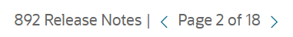
Just April 2021
API Gateway:
Generate SDK for APIs published on API Gateway
Configure Response Caching (e.g. powered by Redis)
Support Request Validation
Service Connector Hub
Connect Streaming to (as source) and from (as target)
Connect Functions as Target and as “task executor”
New releases for Data Integration
Networking:
General availability for IPv6 addressing.
Network Visualizer to visualize network topology
OCR: Container Image scanning for vulnerabilities
Azure-OCI Interconnect in Frankfurt
Database Migration Service (for smooth on prem => OCI migration & upgrade)

Slide 84
Thank you for your attention I hope this was useful
lucas.jellema@amis.nl | technology.amis.nl | @lucasjellema | lucas-jellema
Sources and slides: bit.ly/cloud-native-ogb-apacouc2020

